Slide 1

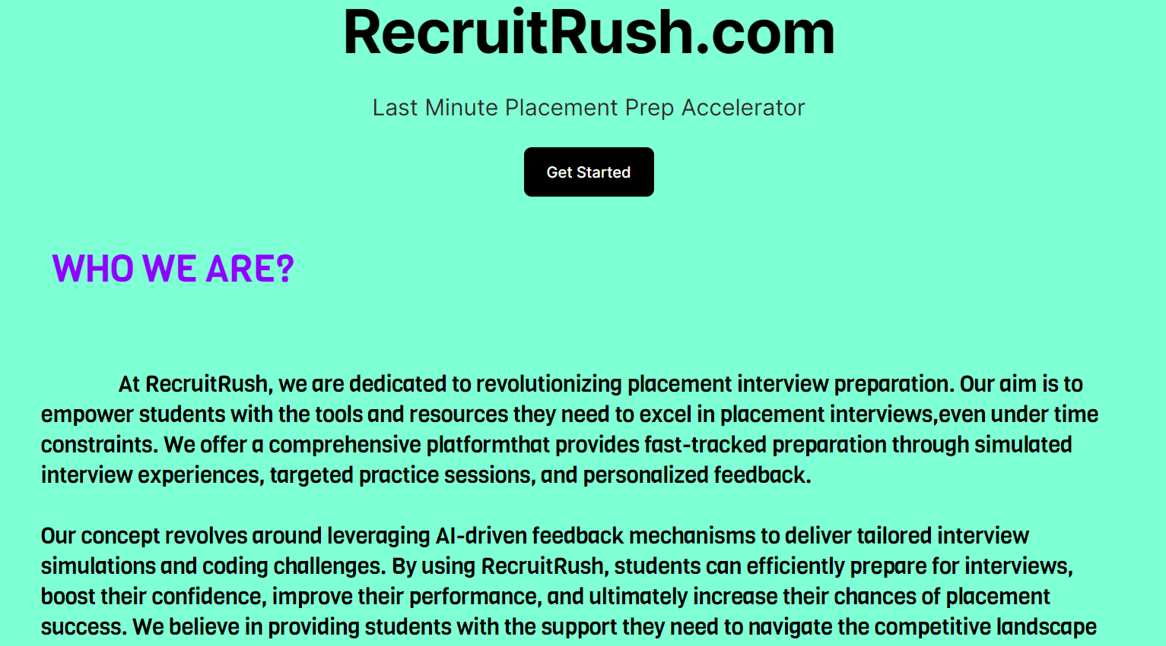
RecruitRush
By Dev-Ninjas
Team Dev-Ninjas
Nakka Bhuvan Lohit Dev - VU21CSEN0100463
Varri Ram Narisimha Tharakeswar - VU21CSEN0100414
Narava Surekha - VU21CSEN0100369
Aparna Akondi - VU21CSEN0100340

Slide 2
Idea of Project
RecruitRush is a dynamic platform tailored to address the urgent needs of students facing last-minute placement interviews.
With its innovative approach, RecruitRush aims to expedite and enhance the preparation process, offering targeted resources and support to students on the brink of their interviews.

Slide 3
Problem statement
In the rush to prepare for last-minute placement interviews, students face the challenge of effectively assessing their knowledge, identifying areas for improvement, and integrating preparation for aptitude, coding, and interview skills.
This urgency often leads to fragmented preparation efforts, leaving students unsure of their readiness and lacking a cohesive strategy to address all aspects of the interview process.

Slide 4
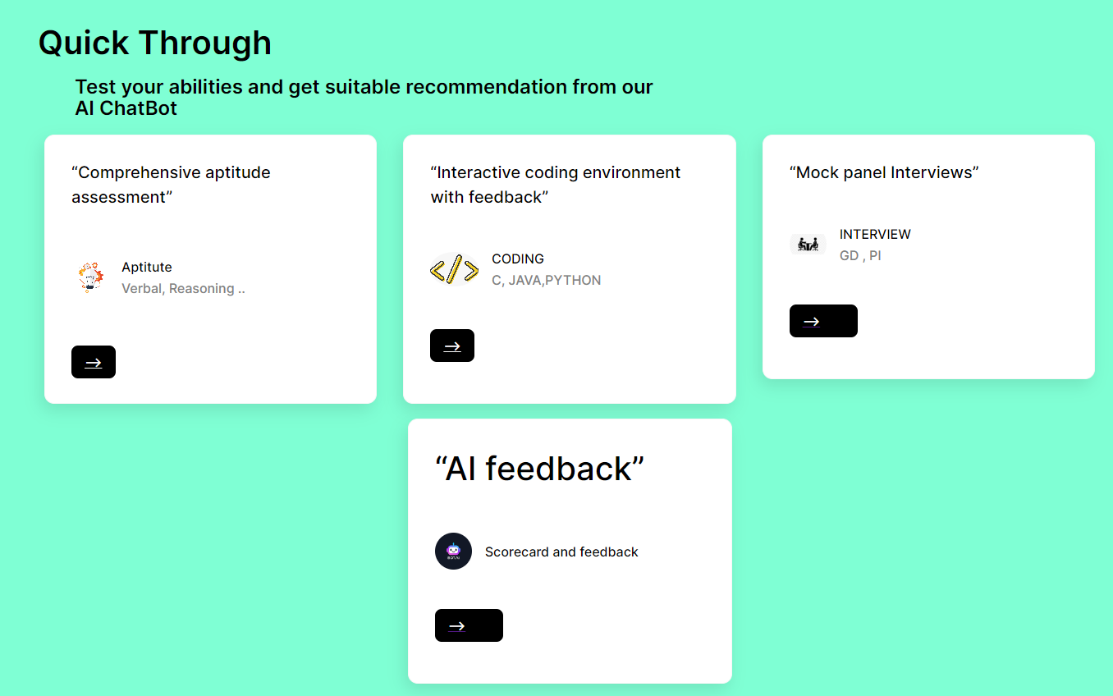
Solution
RecruitRush offers a comprehensive solution by providing quick access to aptitude tests, coding challenges, and interview simulations.
Through these resources, students can efficiently assess their skills, pinpoint weaknesses, and refine their aptitude, coding, and interview techniques.
By streamlining the preparation process, RecruitRush enhances students' readiness for interviews, enabling them to tackle placement opportunities with confidence, even when time is limited.
Our solution is in the form of a Web-Application
https://bhuvan983.github.io/RecruitRush-by-DevNinjas/

Slide 5
Outcomes of our solution - RecruitRush
Efficient Last-Minute Preparation: Designed to accommodate tight timeframes, RecruitRush enables students to make the most of their limited preparation time, ensuring they are well-equipped for their interviews.
Enhanced Confidence: RecruitRush helps students identify strengths and areas for improvement, by constructive feedback which fosters confidence and self-assurance, empowering students to approach interviews with a positive mindset.
Increased Chances of Placement Success: RecruitRush enhances their competitiveness in the job market and increases their likelihood of placement success.

Slide 6
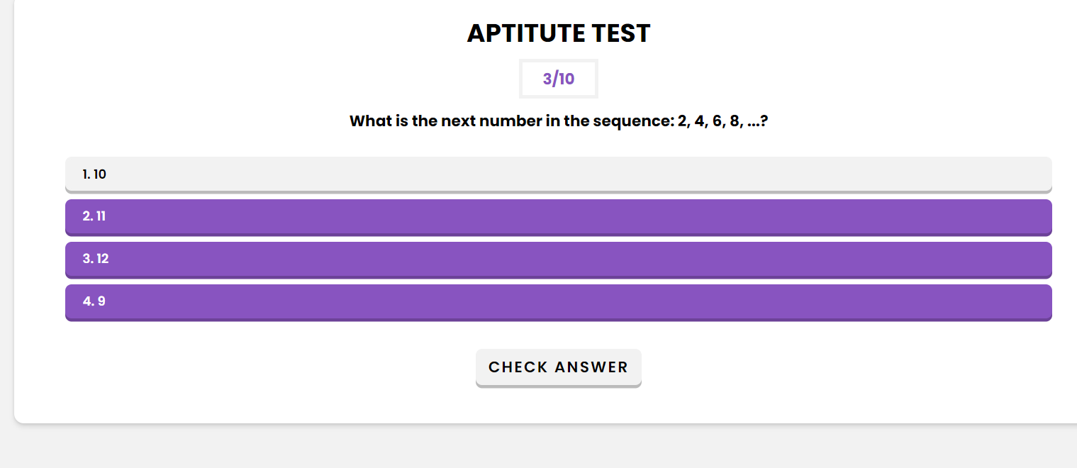
Features of Web-application
Mock Aptitude Quiz with AI feedback
Instant preparation for placement exams with our Mock Aptitude Quiz, designed to simulate real aptitude tests encountered during job interviews.
Test your numerical, verbal, and logical reasoning skills, and receive instant feedback to identify areas for improvement.
1

Slide 7
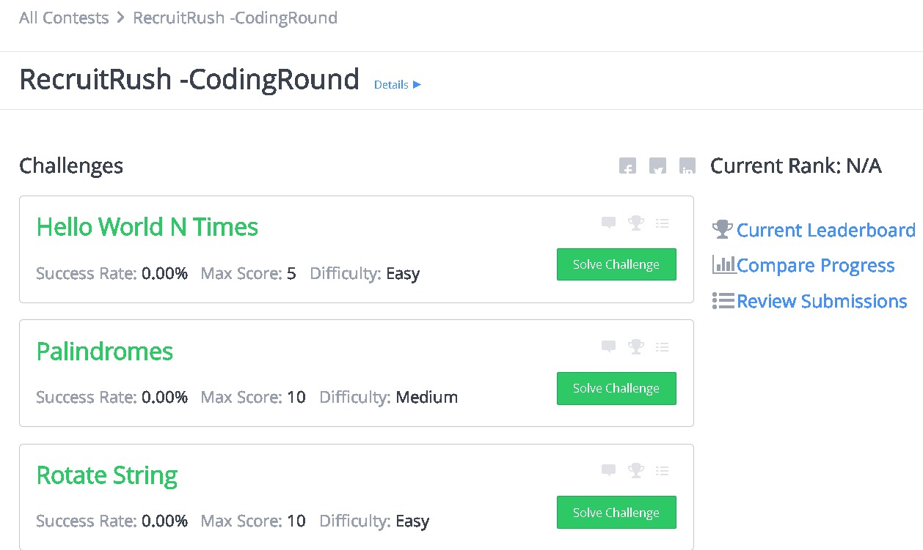
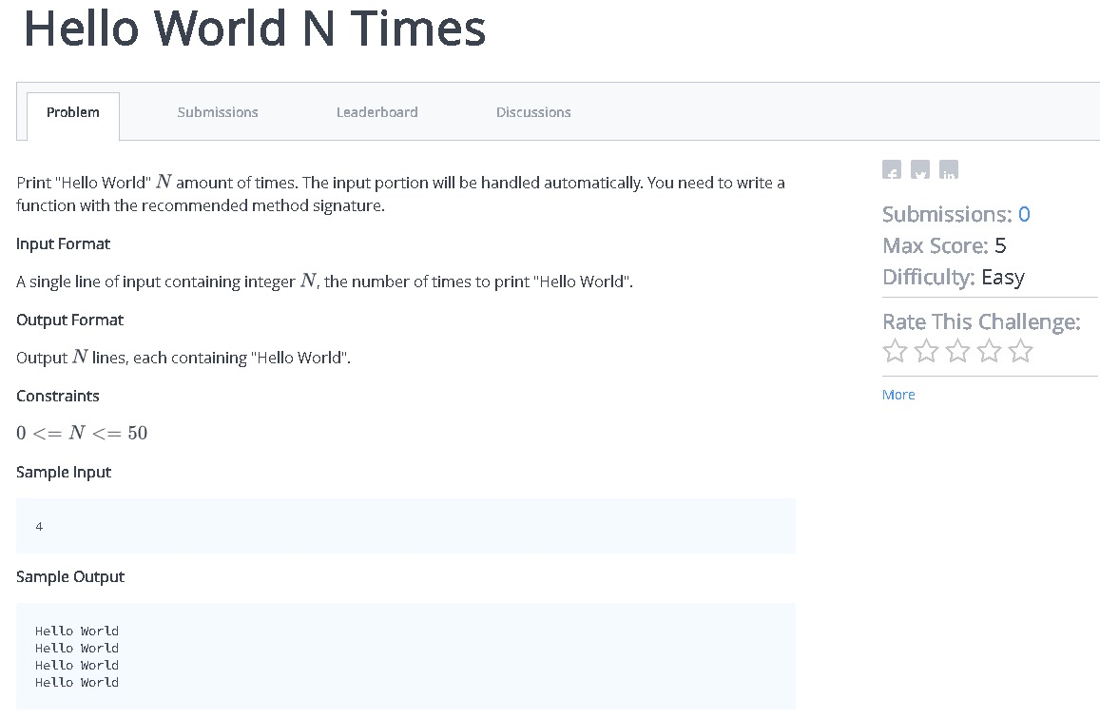
Features of Web-application
02. Coding Practice with AI feedback
Elevate your coding skills with our Coding Test Platform, offering a wide range of coding challenges and projects.
Practice coding in various languages, solve real-world problems, and refine your programming abilities through interactive assessments and detailed performance analysis
1

Slide 8
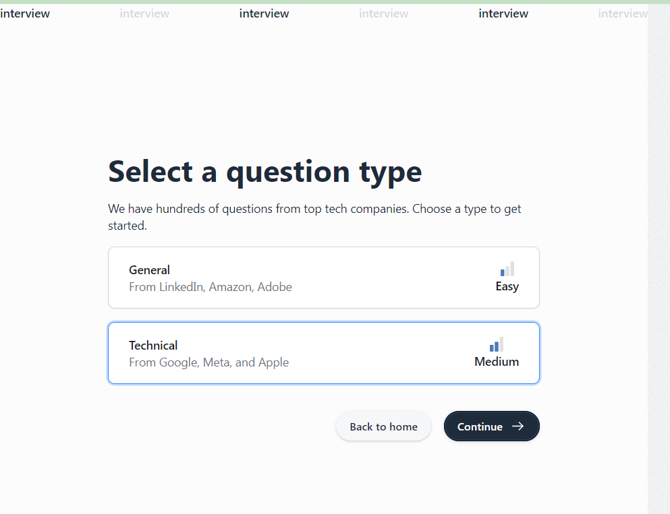

Features of Web-application
03. Online Interview Simulation
Ace your interviews with our Online Interview Preparation platform, featuring simulated interview experiences tailored to your field.
Practice behavioral and technical interview questions, and boost your confidence for your upcoming job interviews
Sample Interview Demo: https://youtu.be/7slWl_CI908
1

Slide 9
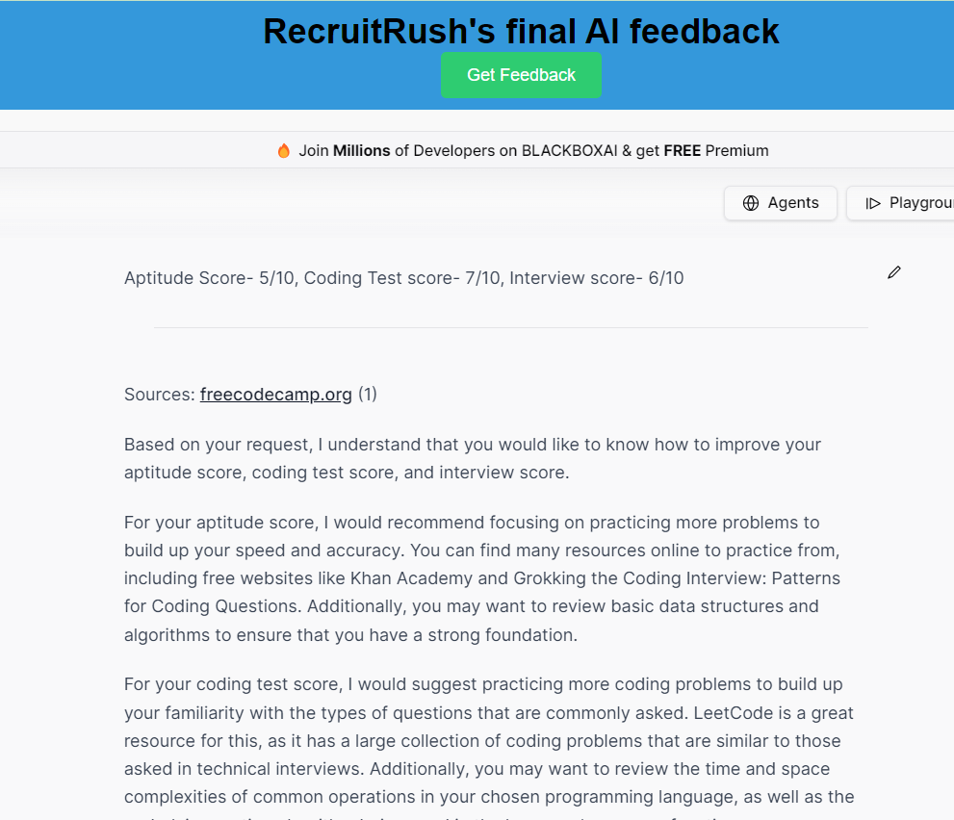
Features of Web-application
04. AI Feedback with Chatbot Integration
Experience personalized feedback like never before with our AI-powered chatbot integration.
Integrated with Mock Aptitude Quiz, Coding Test Platform, and Online Interview Preparation, our chatbot analyzes test results.
Receive tailored feedback, actionable insights, and targeted recommendations to enhance your skills and maximize your success in placement interviews.
1

Slide 10
GitHub Repository:
https://github.com/Bhuvan983/RecruitRush-by-DevNinjas/
Deployed Website: https://bhuvan983.github.io/RecruitRush-by-DevNinjas/

